Slide 1
Methodological approaches to intersectional quantitative analysis: examples from the UniSAFE survey on gender-based violence in universities
Professor Anne Laure Humbert
June 2025
Notes:
Intersectional data collection and analysis
applications of IMLM with UniSAFE data
opportunities for scaling up, what next for understanding intersectional inequalities in the ERA

Slide 2
What is intersectionality?
Notes:
Inequalities are shaped by gender, but also other identities that together create multiple and intersectional forms of discrimination and disadvantage
Identities and characteristics both intersect and interact with each other to shape a person's experiences and opportunities.
However, intersectionality goes beyond the individual level, and the identities and characteristics that may shape experiences.
Instead, intersectionality recognises the structural dimension of power inequalities that shape how the different sets of social relations delineated by various identities and characteristics experience inequalities (Walby et al., 2012).

Slide 3
How can (quantitative) researchers engage with intersectionality theory, and with what challenges?
Notes:
Capturing complexity
Quantitative analysis often struggles to capture the complexity and interaction of multiple identities and characteristics that intersectionality seeks to address.
Identities are experienced simultaneously, and distinguishing between the effects of one or another a difficult endeavour. For someone with multiple underprivileged identities, it might not be possible to clearly delineate which identity/ies results in discrimination.
For another with a mixture of privileged and underprivileged identities, the task of identifying the sources of inequalities might be more difficult still. Unlike a statistical model, identities are complex, and the effects not so clear cut, and it might be thus more viable to consider the potential underprivilege associated with different identities (Harnois, 2013).
Let’s illustrate these key ideas using Weldon’s powerful demonstration of the necessity to consider effects that she calls ‘autonomous effects’ and ‘intersectional effects’ (see Weldon, 2006, pp. 240-244).

Slide 5
Capturing complexity
$$y = c + \text{sex} ×x_{\text{sex}} + \text{race} ×x_{\text{race}}+ e$$
Notes:
Transposing this into quantitative research means it is possible to consider autonomous effects as individual additives terms (fixed effects), with coefficients for ‘sex’ and ‘race’ that provide the effects on these identities, alongside a constant c that can sometimes provide the baseline, and an error term e:

Slide 6
Capturing complexity
$$y = c + \text{sex} ×x_{\text{sex}} + \text{race} ×x_{\text{race}}+ e$$
$$y = c + \text{sex} ×x_{\text{sex}} + \text{race} ×x_{\text{race}}+(\text{sex}\text{∗}\text{race}) ×x_{\text{sex}\text{∗}\text{race}}+ e$$
Notes:
Adding interaction terms shows that different identities can reinforce each other, for example between sex and race, mathematically obtained using the coefficient of ‘sex * race’:

Slide 7
Capturing complexity
Weldon argues that it would be an error to equate this interaction term with an intersectional effect, and that “intersectional effects are by definition effects that cannot be derived as any function of gender, race, and class considered independently […].
No mathematical manipulation of the effects of gender and race will completely capture the way they combine: Intersectional effects are qualitatively different from independent or additive effects” (page 243, emphasis in the original).
Notes:
Weldon argues that it would be an error to equate this interaction term with an intersectional effect, and that “intersectional effects are by definition effects that cannot be derived as any function of gender, race, and class considered independently […].
No mathematical manipulation of the effects of gender and race will completely capture the way they combine: Intersectional effects are qualitatively different from independent or additive effects” (page 243, emphasis in the original).
Mathematically, this is equivalent to writing:
This model includes all three types of effects: the additive effects (sex, race); a multiplicative effect (sex*race) and the intersectional effect (sex-race-for-particular-group). The advantage of using this last term is that is allows for a shift from an analysis of individual level effects, to structural one, i.e. from the effects of sex and race, to the effects of sexism and racism.
It also reflects the fact that it is difficult, if not impossible, for any individual to identify whether their experiences relate to one particular identity or another (Harnois, 2013).

Slide 8
Capturing complexity
$$y = c + \text{sex} ×x_{\text{sex}} + \text{race} ×x_{\text{race}}+ e$$
$$y = c + \text{sex} ×x_{\text{sex}} + \text{race} ×x_{\text{race}}+(\text{sex}\text{∗}\text{race}) ×x_{\text{sex}\text{∗}\text{race}}+ e$$
$$y= c + \text{sex}×x_{\text{sex}} + \text{race} ×x_{\text{race}}+ \left(\text{sex}\text{∗}\text{race}\right)×x_{\text{sex}\text{∗}\text{race}} \\ +(\text{sex}\text{−}\text{race}\text{−}\text{for}\text{−}\text{particular} \text{group})×x_{\text{sex}\text{−}\text{race}\text{−}\text{for}\text{−}\text{particular} \text{group}}+ e$$
Notes:
Weldon argues that it would be an error to equate this interaction term with an intersectional effect, and that “intersectional effects are by definition effects that cannot be derived as any function of gender, race, and class considered independently […].
No mathematical manipulation of the effects of gender and race will completely capture the way they combine: Intersectional effects are qualitatively different from independent or additive effects” (page 243, emphasis in the original).
Mathematically, this is equivalent to writing:
This model includes all three types of effects: the additive effects (sex, race); a multiplicative effect (sex*race) and the intersectional effect (sex-race-for-particular-group). The advantage of using this last term is that is allows for a shift from an analysis of individual level effects, to structural one, i.e. from the effects of sex and race, to the effects of sexism and racism.
It also reflects the fact that it is difficult, if not impossible, for any individual to identify whether their experiences relate to one particular identity or another (Harnois, 2013).

Slide 9
Multi-level intersectional modelling (MAIHDA) as a possible alternative?
Notes:
To reconcile intersectionality theory with quantitative methods, researchers working mostly in the field of epidemiology or in wider field of health sciences, have developed intersectional multi-level modelling as an alternative approach (Bauer et al., 2021; Evans et al., 2018; Merlo, 2018).

Slide 10
The ‘MAIHDA’ approach: intersectional membership groups
The key idea behind this alternative approach is that individuals may show similar experiences with their intersectional membership group.
Just like two individual experiences may be shaped by living in the same geographical area, intersectional multi-level modelling acknowledges that experiences may also be similar among people that share the same sets of characteristics.
Notes:
MAIHDA (Multilevel analysis of individual heterogeneity and discriminatory accuracy) makes use of this multilevel approach.
It therefore challenges the assumption that individuals are independent of each other, and that the structure of their identity does not matter for understanding their experiences and outcomes.
It also moves the focus of analysis from that of individual only, and transposes it to the structural level as well, and thus responding empirically to the need to consider how identities are relational – extending Connell 1992 p736 work on the ‘relational character of gender’ – and how differences among groups arise within these structural relationships and across a range of socio-spatial contexts (Harnois, 2013), (how gender operates within and across different social contexts)

Slide 11
Application in the UniSAFE project

Slide 12
UniSAFE survey
Over 42,000 responses collected
14
languages
Focus
on experiences of gender-based violence
Largest cross-cultural survey in Europe in the research sector on gender-based violence
46
Research Performing Organisations in 15 countries
Field time between 17 January and
1 May 2022
Lipinsky, Anke, Schredl, Claudia, Baumann, Horst, Lomazzi, Vera, Freund, Frederike, Humbert, Anne Laure, Tanwar, Jagriti, & Bondestam, Fredrik. (2021). UniSAFE D4.1 Final UniSAFE-Survey Questionnaire. Zenodo. https://doi.org/10.5281/zenodo.5746611

Slide 13
Respondents‘ characteristics
The sample includes in total 42,186 respondents, age 18+
43% of respondents are staff
57% of respondents are students

Slide 14
Prevalence of gender-based violence
Note: Prevalence was calculated as the weighted number of cases reporting at least one experience of violence divided by the total number of valid cases, multiplied by 100, i.e. all cases coded as ‘Prefer not to say’ or ‘No answer: break-off’ were excluded from the calculation. Prevalence was calculated individually for the specific forms of violence and for any form of gender-based violence. For any form of violence cases were excluded from the calculation if there was no valid data for any of the specific forms of violence. Source of data: UniSAFE survey
Notes:
Over 42,000 people responded to the UniSAFE survey and it shows the scale of the problem. Nearly two in three of the survey respondents report having experienced at least one form of gender-based violence in the context of their work or studies.
Nearly one in three, report at least one incident of sexual harassment. And 3% report having experienced sexual violence.
Although respondents were encouraged to take the UniSAFE survey whether they had experiences to report or not, any survey results may be affected by self-selection bias, whereby people who have had bad experiences could be more inclined to take part. However, measuring gender-based violence is also notoriously difficult because it is assumed that the incidents that are disclosed only represent a fraction of the actual incidents.
Focusing on numbers of individuals rather than prevalence rates, our results show, for example, that there are approximately 12,000 respondents saying they had experienced sexual harassment. For sexual violence, this concerns over 1,000 of our respondents. Even one single incident of gender-based violence is too much.

Slide 15
Intersectional multi-level modelling
By using intersectional multilevel modelling we are able to account to how experiences of gender-based violence might relate to countries, organisations and intersectional strata
We use a cross-classified multi-level model with a logit link function.
The random intercept model is expressed as:
$log\left(\frac{π_{ijk}}{{1− π}_{ijk}}\right)= β_{0}+ β_{1}x_{1i}$ $+ u_{country(i)}^{(4)}+u_{organisation(i)}^{(3)}+u_{intersectional strata(i)}^{(2)}$
with $u_{country(i)}^{(4)}\sim N\left(0, σ_{u(4)}^{2}\right)$, $u_{organisation(i)}^{(3)}\sim N\left(0, σ_{u(3)}^{2}\right)$, and $u_{intersectional strata(i)}^{(2)}\sim N\left(0, σ_{u(2)}^{2}\right)$

Slide 16
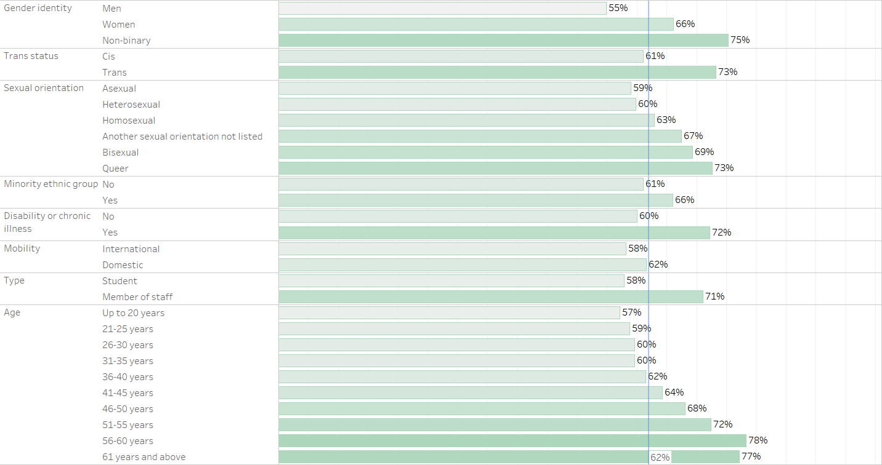
Predicted probabilities of prevalence of any forms of gender-based violence
Source of data: UniSAFE survey

Slide 17
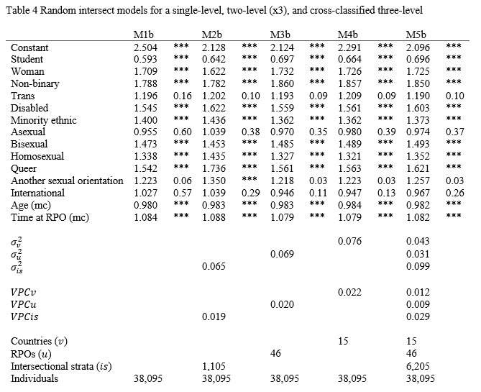
From single level modelling…
… to increasingly complex multilevel models
(Humbert, 2024)

Slide 18
How to bring MAIHDA further in (contextual) intersectional multilevel modelling?
Notes:
The epistemological divide between intersectionality and quantitative methods is not unbridgeable!
But let’s not forget about the critical roots of intersectionality: MAIHDA must be continuously informed by a deep theoretical and critical awareness of intersectionality’s foundational commitments
Intersectionality is a ‘travelling’ theory, and MAIHDA seems to be one the latest destinations?
The MAIHDA approach should serve as a tool for intersectional inquiry rather than a substitute for intersectional theory itself

Slide 19
Bridging theory and method
The MAIHDA approach certainly stands out, as a particularly compelling innovation by quantifying structural inequalities more effectively
But let’s not forget context!
The intersectional multilevel modelling approach allows for three essential analytical strategies: disaggregation, socio-contextual model specification, and contextual analysis

Slide 20
From description to explanation
Moving beyond MAIHDA
MAIHDA has advanced descriptive intersectional analysis
The field must now move towards analysing underlying processes and mechanisms
Towards analytical intersectionality
Use mediated moderation and moderated mediation to explore complex causal relationships
Methods should uncover how inequalities arise, not just that they exist

Slide 21
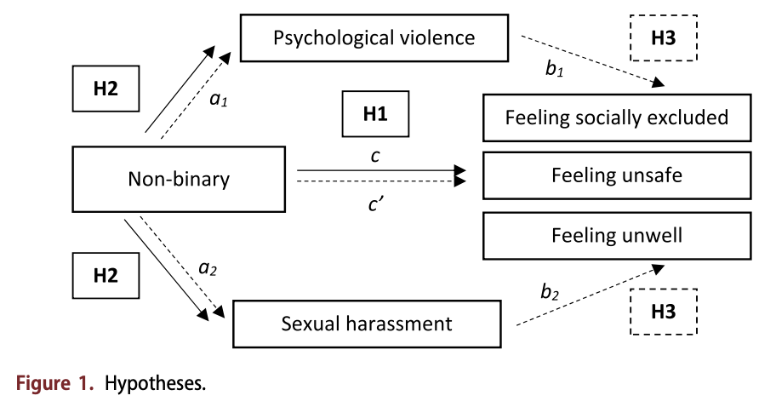
Non binary experiences of (gender-based) violence
Source: Humbert et al 2025

Slide 22
From description to explanation
Moving beyond MAIHDA
MAIHDA has advanced descriptive intersectional analysis
The field must now move towards analysing underlying processes and mechanisms
Towards analytical intersectionality
Use mediated moderation and moderated mediation to explore complex causal relationships
Methods should uncover how inequalities arise, not just that they exist
Rethinking MAIHDA terminology?
MAIHDA risks narrowing methodological scope
Models must reflect intersectionality’s contextual and structural nature
Towards (Contextual) Intersectional Multilevel Modelling? I-MLM or (C)I-MLM?

Slide 23
Further applications?
GEAM surveys (forward?)
MORE4, or another MOREX (forward?)
LFS, SILC, SES ?
ESS? EVS?
Eurobarometers?
Dedicated data collection?

Slide 24
Concluding remarks
In this presentation, I hope to have inspired you to engage in quantitative intersectional research…
… either in your own capacity if you feel confident in carrying out statistical analysis
… or by partnering with quantitative social scientists who also have expertise in intersectionality.
Notes:
Thank you

Slide 25
Methodological approaches to intersectional quantitative analysis: examples from the UniSAFE survey on gender-based violence in universities
Professor Anne Laure Humbert
June 2025
Notes:
Intersectional data collection and analysis
applications of IMLM with UniSAFE data
opportunities for scaling up, what next for understanding intersectional inequalities in the ERA

Slide 26
References
Bauer, G. R., Churchill, S. M., Mahendran, M., Walwyn, C., Lizotte, D., & Villa-Rueda, A. A. (2021). Intersectionality in quantitative research: A systematic review of its emergence and applications of theory and methods. SSM - Population Health, 14, 100798.
Cho, S., Crenshaw, K. W., & McCall, L. J. (2013). Toward a Field of Intersectionality Studies: Theory, Applications, and Praxis. Signs: Journal of Women in Culture and Society, 38, 785 - 810.
Evans, C. R., Williams, D. R., Onnela, J.-P., & Subramanian, S. V. (2018). A multilevel approach to modeling health inequalities at the intersection of multiple social identities. Social science & medicine, 203, 64-73.
Hancock, A.-M. (2007). When Multiplication Doesn't Equal Quick Addition: Examining Intersectionality as a Research Paradigm. Perspectives on Politics, 5(1), 63-79.
McCall, L. (2005). The Complexity of Intersectionality. Signs: Journal of Women in Culture and Society, 30, 1771-1800.
Merlo, J. (2018). Multilevel analysis of individual heterogeneity and discriminatory accuracy (MAIHDA) within an intersectional framework. Social science & medicine, 203, 74-80.
Spierings, N. (2012). The inclusion of quantitative techniques and diversity in the mainstream of feminist research. European Journal of Women's Studies, 19(3), 331-347.
Walby, S., Armstrong, J., & Strid, S. (2012). Intersectionality: Multiple Inequalities in Social Theory. Sociology, 46(2), 224-240.

