Slide 1
Intersectional data collection & analysis. The organisational perspective
Jörg Müller, PhD
Universitat Oberta de Catalunya
ERA5 Subgroup Meeting
Brussels, 6th June 2025

Slide 2
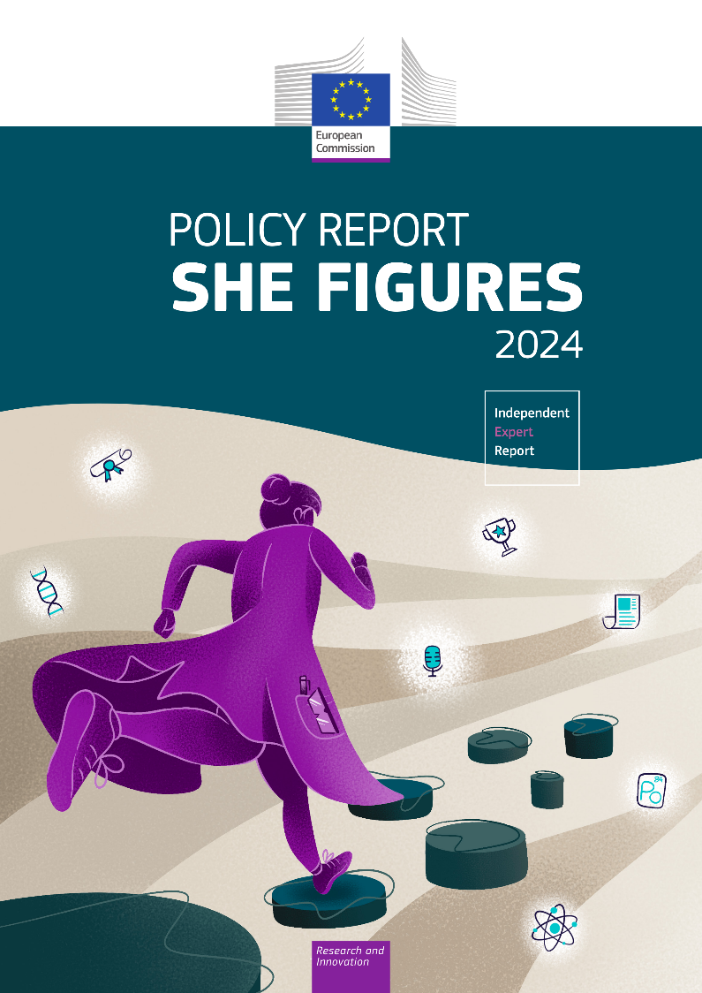
Müller, Jörg, and Anne Laure Humbert. 2025. “Data Collection and Analysis for Inclusive GEPs: Intersectional Challenges and Solutions for R&I Institutions.” pp. 39–76 in She figures 2024: policy report, edited by European Commission. Publications Office of the European Union.
doi.org/10.2777/934401
Notes:
Instead of pressing chapter in the policy report into presentation, two critical reflections, two issues that tend to fall under the table when discussing data collection / monitoring from intersectional perspective:
Need to focus on the eye of the hurricane, on the culture and values of those at the center of society, of those in power and with high status: white, middle-aged, hetereosexual men. Because it is the dominant masculinity, their culture and values that drives marginalization.
Need to focus on purpose of data collection: structural inequalities, main discussion should be on social, structural inequalities rather than social identities and social categories.

Slide 3
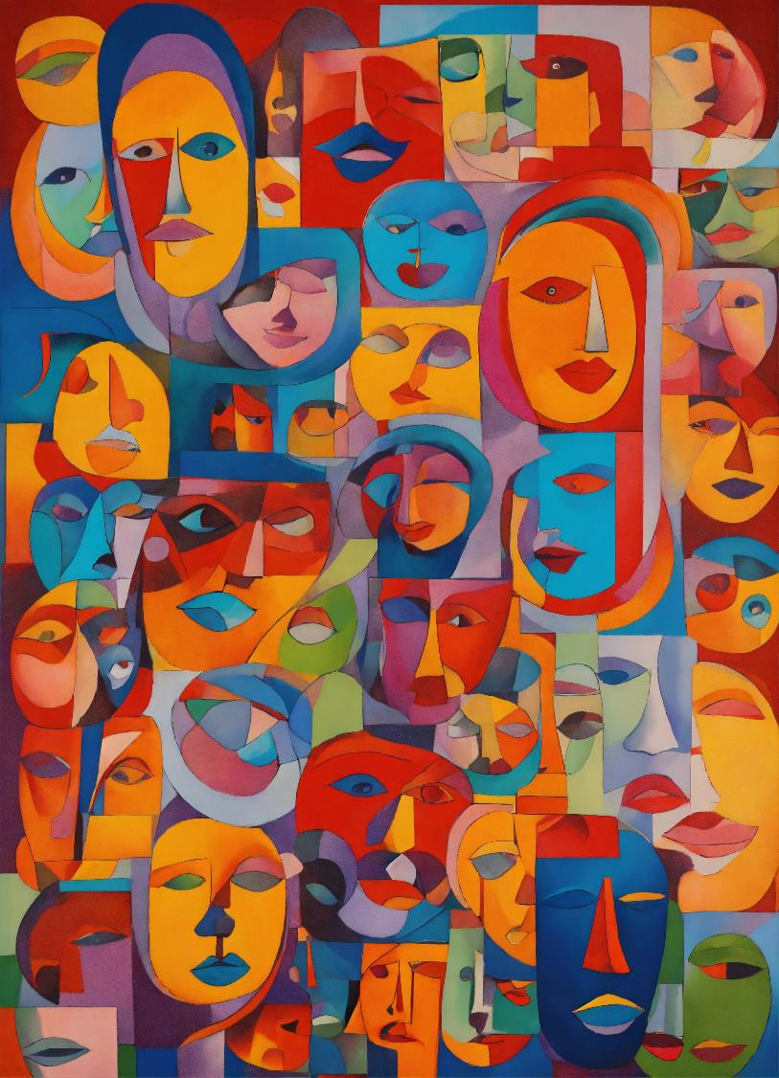
Equality Diversity Inclusion
Equality
Equality recognizes the historical and structural relations of inequality that are build upon social categories and address these
Diversity
Socio-demographic and functional characteristics of persons (e.g. race, ethnicity, gender, sex, sexual orientation, religious beliefs, socio-economic class, disability, or educational attainment)
Inclusion
Participatory, transformative process guided by non-negotiable core values

Slide 4
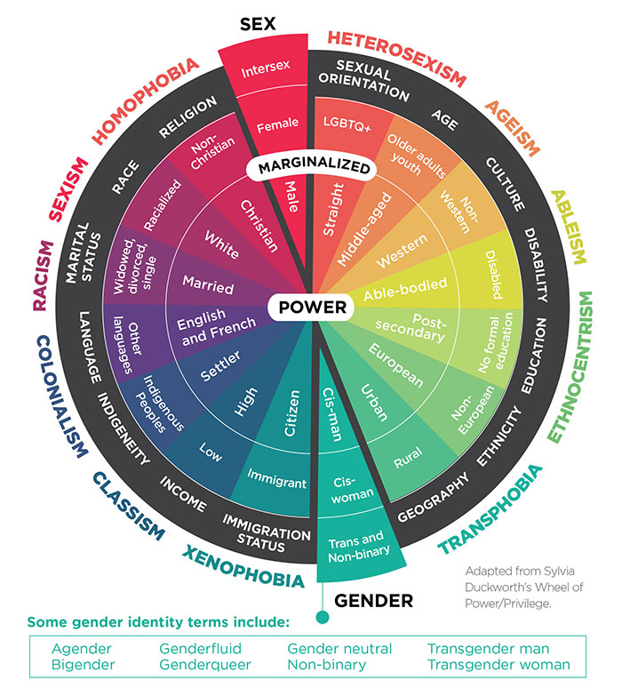
Intersectionality – Critical Dimensions
Coined by Kimberlé Crenshaw 1989 to show how Black women encounter combined race and gender (labour) discrimination – while no legal protection for this “new class of minority” group existed.
Intersectionality focuses on the lived experience of individuals
Critical perspective: how power shapes experience, knowledge, thought.
Individuals have multiple and intertwined social identities, inhabiting variety of positions of privilege and disadvantage at the same time
Source: https://cihr-irsc.gc.ca/e/52352.html
Notes:
Multiple identities / colors. The wheel shows us multiple dimensions of social identities represented through different colors.
Ordered: center/margin. Importantly, these identities are ordered according to privilege and disadvantage: at the center are privileged identities while at the margin, are those that are rather disadvantage and marginalized. At the center are those identities “in power”, while at the margin are those identities that are disadvantaged, excluded, oppressed.
As individuals we always occupy different positions of disadvantage and privilege at the same time: as a white person you can be at the center of race, yet be at the margin due to your sexual orientation. While you can be at the center in terms of an abled-body, you can be at the margins in terms of citizenship.
When we talk about intersectionality, we tend to focus on the excluded – those at the margin of the society / wheel / possibly overlapping marginalization.
Especially when we think about data and monitoring – we discuss how we can gather data on migrant-status, ethnicity, race, religion and all the other protected personal information. However, the key is who is in the center! Who is in power!
It is my contention that we need data on who is in the center!! Because it is the culture and values of the privileged that result in exclusion.
Historic:
Court ruled in DeGraffenreid v General Motors that no discrimination based on gender was present (GM did hire women); neither discrimination based upon race (GM did hire black men). There is no case for Black Women. Reasoning by the court is interesting in terms of avoiding the explosion of new protected minority categories:
“The prospect of the creation of new classes of protected minorities, governed only by the mathematical principles of permutation and combination, clearly raises the prospect of opening the hackneyed Pandora's box.” (Crenshaw 1989)

Slide 5
doi:10.1016/j.oneear.2025.101314
Notes:
What do I mean by collecting data on the privileged?
Recent paper Valdez in the field of “ecology and conservation”.
Lord of the rings “Gollum” – ring possession main objective. Widespread resource hoarding, gatekeeping, possessive territorial behavior.
Possessive behaviour – main perpetrator: high profile researchers, supervisors, in short - those in power which affects mainly those without power: early career and marginalized researchers.
It is the behaviour of those in power, the privileged, the high status, high profile researchers that drives out the rest.

Slide 6
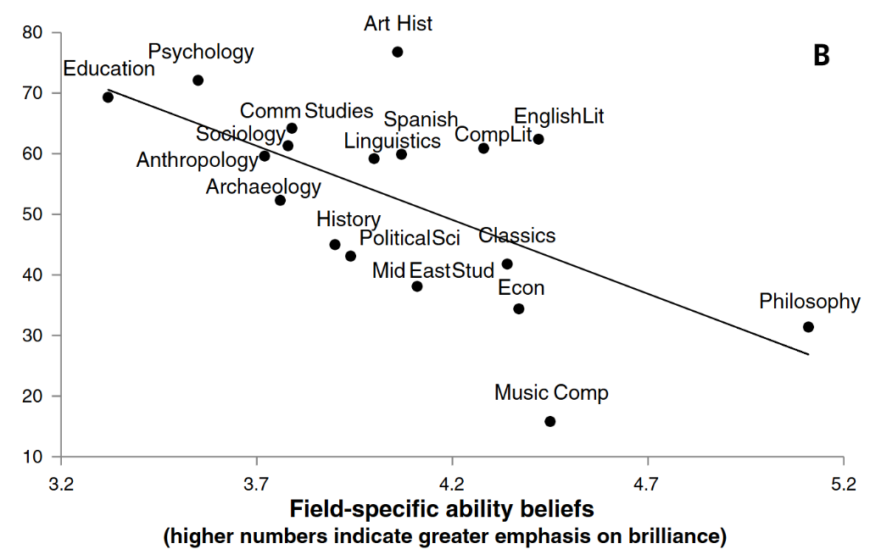
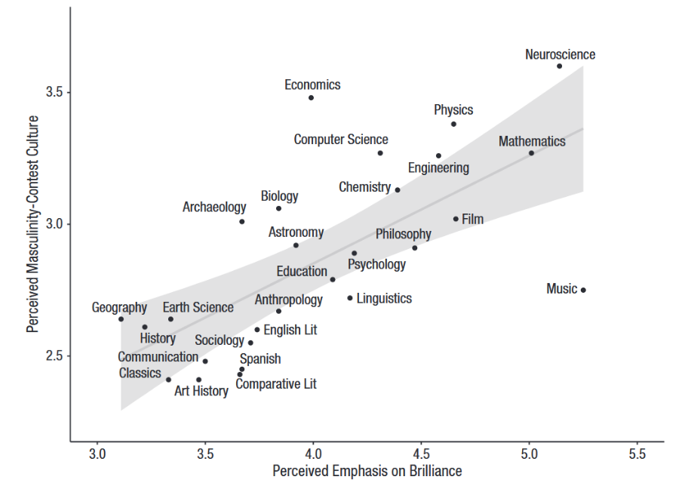
Masculinity Contest Culture & Brilliance
Leslie et al. (2015). “Expectations of Brilliance Underlie Gender Distributions across Academic Disciplines.” Science doi: 10.1126/science.1261375.
Vial et al., (2022) “An Emphasis on Brilliance Fosters Masculinity-Contest Cultures.” Psychological Science. doi: 10.1177/09567976211044133.
Notes:
Why is it that messages of brilliance undermine women’s interest?
Masculinity Contest Culture - gives rise to a “dog eat dog” atmosphere of ruthless competition, which discourages women’s participation and undermines their wellbeing.
Masculinity Culture defined by those in the center, in power that drives others out.

Slide 7
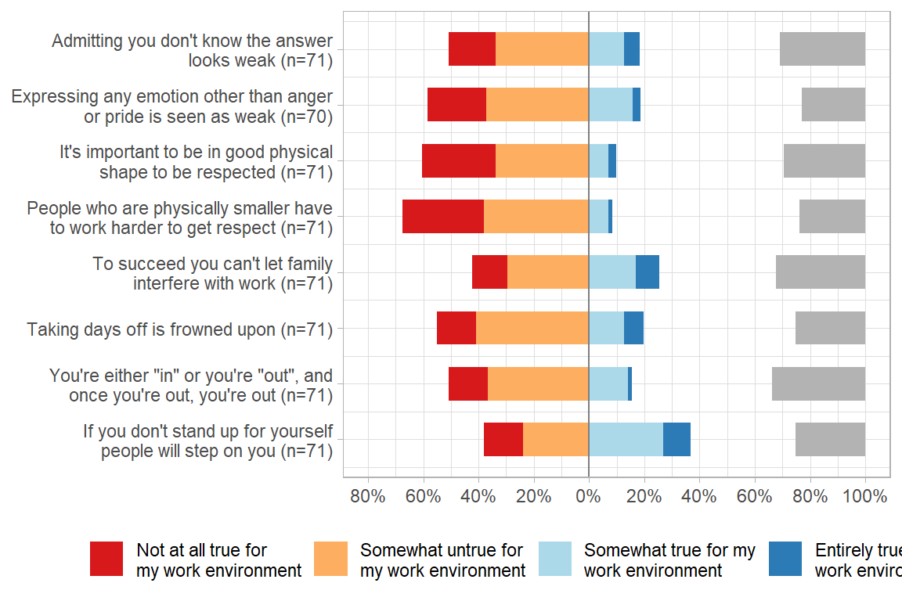
Organisational Culture & Climate
Intersectional data monitoring needs to focus on culture and values associated with masculinity
Culture and values at the organisational level: MCC is a group-level construct best examined at department, faculty, lab, university level.
The organisational level provides insights into these key masculinity values and culture that drives women and marginalised groups out.
GEAM example
Notes:
If we want to understand the mechanisms that drives women and minoritised groups out, we need to look at the dominant masculinity culture at the organisational level.
MCC is an organisational level construct: how strongly an organization or organizational unit endorses masculine norms. Ideal to explore departments, faculties, labs, etc. Think about male vs. female dominated faculties?!
Four facets: “show no weakness”, “Stamina”, “Put work first”, “Dog-eats-dog”.
Addressing masculinity contest culture is likely to improve the research culture and work climate for all.
GEAM incorporates MCC scale over the years. What we see it correlates quite strongly with microaggressions, gbv, etc. The masculinity culture is key and needs to be addressed through policies which will benefit everybody else who is not at the center!
“‘[t]he name of the problem addressed is white supremacy and male dominance, or white male dominance, not race and sex classifications”

Slide 8
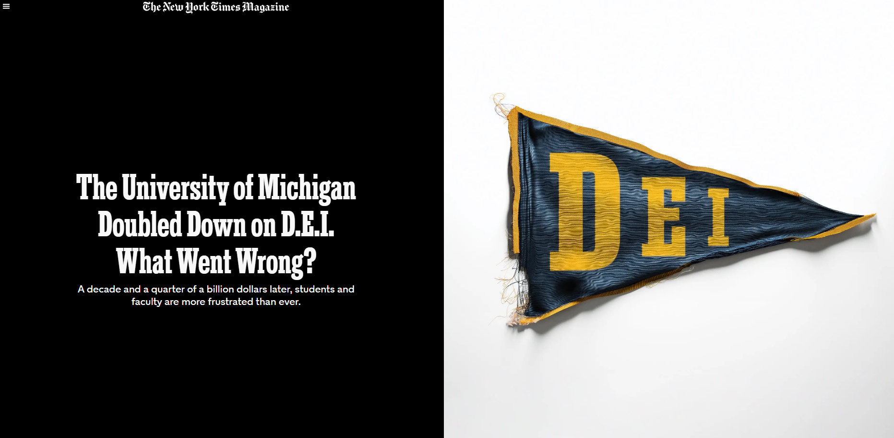
Notes:
Interesting read in times of backlash.
First, shows the limits of formalised / policy approach. Impressive administrative infrastructure in place - including data monitoring and surveys - but it has not really improved the experience of students and professors. If there is not a basic culture and ability to discuss and listen, then it is hard to move forward.
Second: don’t loose sight of structural inequalities, the things that matter.
Metoo, murder of George Floyd: “There was a complete disconnect between the source of their anger and the target of it,” the former dean said. “It was insatiable.”
“The most strident critics were sometimes not the most marginalized students, but peers who claimed to be fighting on their behalf.”
DEI theory and debates obscure real-world obstacles to inclusion. Botanical garden - discussing alternative nomenclature for plants and knowledge when the biggest impediment to making the garden more accessible: “It is hard to get there without a car.” There was never any funding for that.
What is the purpose of data collection? Need a clear understanding of what needs to change. Don’t loose sight of the structural problems and how to change them.

Slide 9
Notes:
Persistent funding gap for black scientists in the National Institutes of Health in the US.
Revised peer review system, biased review
Lottery of top excellent proposals
Refocus, prioritize topic areas more popular among black scientist.
Use scorecard for grant allocation to address the funding gap.
BUT solution: just fund one additional grant for each NIH.
Data is useless without a clear understanding of what needs to change. What is the purpose of data collection?

Slide 10
Purpose of data collection
Social Categories
Structural Inequalities
Theory of Change
Gender
Woman, Man, Non-binary, Self-identify as: …
Sexual orientation
Race / ethnicity
Religion
Disabilities/health
Socio-economic status
Citizenship
…
Gender Norms
Caregiver strain
Time use
Work strain
Gender-related traits
Competitive
Communal, expressive
Independence
Risk-taking
Gender relations
Social support
Discrimination
Quality of family relations
Working conditions
Precarious contracts
Work allocation: teaching/care vs. research
Recognition of pastoral activities, tasks
Outcomes / Impact
Mental & physical health
Job satisfaction
Stress / burnout
Dropout intentions
Understand context
Geographic
Historic
Participative from start to finish in order to understand needs and risks
Build on comparative research: what works where, when, in what order and combination
Nielsen et al, (2021) “Gender-Related Variables for Health Research.” doi: 10.1186/s13293-021-00366-3.
Notes:
Intersectional data collection is preoccupied with socio-demographic variables: how to classify and how to collect these within existing legal frameworks / restrictions.
BUT: this is not the main issue. The main issue: what do you collect the data for?
AND: who does this help you to transform inequalities?
Gender related variables of health research – away from socio-demographic categories to structural features: gender roles, norms, gender status hierarchy – across disciplines.

Slide 11
Intersectionality +
Equality Data Collection
Deconstruction
Power
Context
Complexity
Relationality
Self- identification
Purpose
Participation
Anonymity
Consent
Redraw categorical boundaries
Avoid “othering”
Theory of Change
Intersectionality
Link privilege & oppression
Equality Data Collection
“Racism not race”
More data ≠ more justice
Non-additive
Geographic & historic
From start to finish
1. Prepare
2. Measure
3. Analyse
Notes:
Focus on the mechanisms how power and privilege is preserved.
More data is not more justice! What’s the purpose. Needs to be tied to historic inequalities and a transformatory project not a protection of individual feelings of identity.
Many of these issues are relatively easy to comply with at the organisational level: context and participation is more bounded; purpose more precise, categories more localized and relevant.

Slide 12
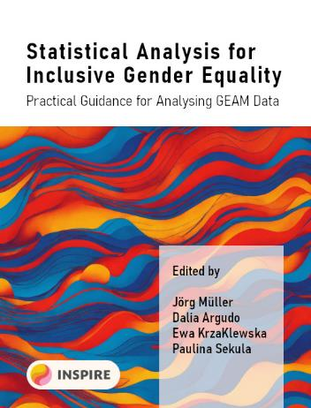
Recommendations & Tools
Do not reduce intersectionality to socio-demographic categories
Intersectionality is a critical lens to understand and address how multiple social identities are woven into hierarchies of oppression and privilege
Be clear about the purpose, benefits and risks of data collection
Build capacity for more advanced analytical techniques to account for the complex, non-additive nature of intersectionality
Useful tools
Gender Equality Audit and Monitoring (GEAM) tool
geamtool.eu/analysis
geamtool.eu/manual
Diversity Minimal Item Set (DiMIS)
gender.charite.de/en/measures/
Notes:
Importance of organisational level.

Slide 13
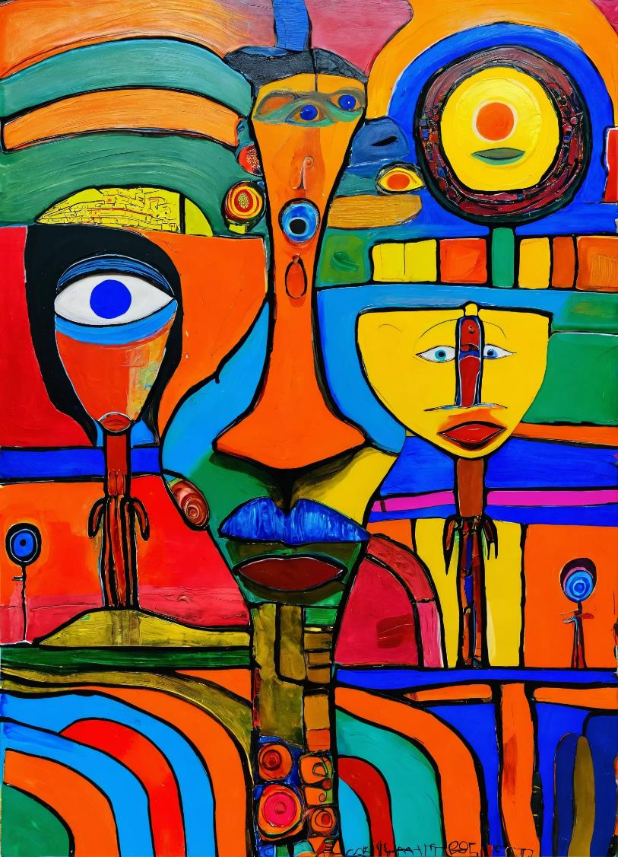
Thank you!
Jörg Müller
jmuller@uoc.edu
https://www.inspirequality.eu/
https://www.gender-ict.net

Slide 14
References
Aldercotte, A., Caprile, M., Guyan, K., Malibha-Pinchbeck, M., Müller, J., Palmén, R., & Startin, C. (2021). ACT - Gender Equality Audit and Monitoring (GEAM)—Version 2. Zenodo. https://doi.org/10.5281/zenodo.5348197
Bauer, G. R., Churchill, S. M., Mahendran, M., Walwyn, C., Lizotte, D., & Villa-Rueda, A. A. (2021). Intersectionality in quantitative research: A systematic review of its emergence and applications of theory and methods. SSM - Population Health, 14, 100798. https://doi.org/10.1016/j.ssmph.2021.100798
Beeckmans, J., Zanoni, P., & Van Laer, K. (2023). Intersectional policies in Higher Education and Research: A scoping literature review [Deliverable 2.1 INSPIRE Project]. INSPIRE Centre of Excellence. https://zenodo.org/records/10033571
British Columbia’s Office of the Human Rights Commissioner. (2020). Disaggregated demographic data collection in British Columbia: The grandmother perspective. Office of the Human Rights Commissioner. https://bchumanrights.ca/wp-content/uploads/BCOHRC_Sept2020_Disaggregated-Data-Report_FINAL.pdf
Canadian Institutes of Health Research, & Bauer, G. R. (2021, October 4). Meet the Methods Series: Quantitative intersectional study design and primary data collection. The Canadian Institutes of Health Research (CIHR). https://cihr-irsc.gc.ca/e/52352.html
Castillo-Ortiz, P., Ali, A., & Samanta, N. (2019). Gender, intersectionality, and religious manifestation before the European Court of Human Rights. Journal of Human Rights, 18(1), 76–91. https://doi.org/10.1080/14754835.2019.1581054
Christoffersen, A. (2017). Intersectional approaches to equality research and data. Equality Challenge Unit. http://www.ecu.ac.uk/wp-content/uploads/2017/04/Research_and_data_briefing_2_Intersectional_approaches_to_equality_research_and_data.pdf
Collins, P. H., & Bilge, S. (2020). Intersectionality (2nd edition). Polity Press. https://www.amazon.es/Intersectionality-Concepts-Patricia-Hill-Collins/dp/0745684491
Crenshaw, K. (1989). Demarginalizing the Intersection of Race and Sex: A Black Feminist Critique of Antidiscrimination Doctrine, Feminist Theory and Antiracist Politics. University of Chicago Legal Forum, 1989(1), 139–167.
ENAR. (2019). Intersectional discrimination in Europe: Relevance, challenges and ways forward. European Network against Racism. https://www.enar-eu.org/intersectional-discrimination-in-europe-relevance-challenges-and-ways-forward/
Garnett, B. R., Masyn, K. E., Austin, S. B., Miller, M., Williams, D. R., & Viswanath, K. (2014). The Intersectionality of Discrimination Attributes and Bullying Among Youth: An Applied Latent Class Analysis. Journal of Youth and Adolescence, 43(8), 1225–1239. https://doi.org/10.1007/s10964-013-0073-8 Nielsen, Mathias W., Marcia L. Stefanick, Diana Peragine, Torsten B. Neilands, John P. A. Ioannidis, Louise Pilote, Judith J. Prochaska, Mark R. Cullen, Gillian Einstein, Ineke Klinge, Hannah LeBlanc, Hee Young Paik, and Londa Schiebinger. 2021. “Gender-Related Variables for Health Research.” Biology of Sex Differences 12(1):23. doi: 10.1186/s13293-021-00366-3.
Rodó-de-Zárate, M. (2014). Developing geographies of intersectionality with Relief Maps: Reflections from youth research in Manresa, Catalonia. Gender, Place & Culture, 21(8), 925–944. https://doi.org/10.1080/0966369X.2013.817974
Stadler, G., Chesaniuk, M., Haering, S., Roseman, J., Straßburger, V. M., Martina, S., Aisha-Nusrat, A., Maisha, A., Kasia, B., Theda, B., Pichit, B., Marc, D., Sally, D. M., Ruth, D., Ilona, E., Marina, F., Paul, G., Denis, G., Ulrike, G., … Mine, W. (2023). Diversified innovations in the health sciences: Proposal for a Diversity Minimal Item Set (DiMIS). Sustainable Chemistry and Pharmacy, 33, 101072. https://doi.org/10.1016/j.scp.2023.101072

